Slide 1

Churn Forecasting
Customer Churn Forecasting
Final Project Demo
Machine Learning
INFO 656-01
By Erik Hannell

Slide 2
Churn Forecasting
Agenda
1
2
Project Background & Information
Code Walkthrough
Introduction
Project: Develop machine learning models to predict “churn” (customer loss)
Problem: How can a company avoid losing customers?
Dataset: Customer database from a Telecom company
Models: Logistic Regression, Random Forest & Layered Neural Network

Slide 3


Churn Forecasting
Problem – Forecast client behavior
“Churn” is the event of customers leaving a company, i.e., stops purchasing its services
Common challenge for most businesses
Businesses strive to minimize churn by optimizing customer retention
Problem – businesses will suffer if they do not understand the behavior of its clients

Slide 4




Churn Forecasting
Why – Key Succuss Factor
Businesses will always benefit from understanding their customer’s behavior, particularly churn
The cost of acquiring new clients typically exceeds that of retaining current ones
New client acquisition has historically been 5-7x more expensive compared to retention
Why – avoid diminishing revenues and maintain strong client satisfaction
New Client Acquistion
Cost: 500 USD
Client Retention
Cost: 100 USD

Slide 5
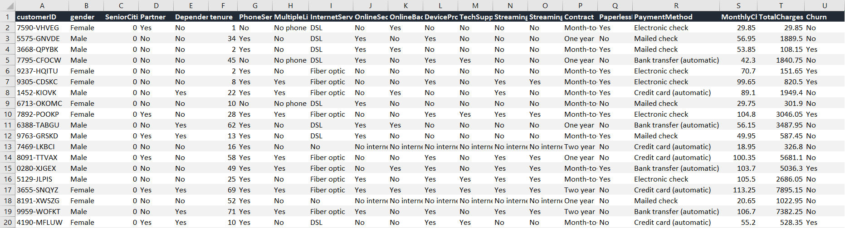
Churn Forecasting
About the Dataset
Source: Released by IBM Knowledge Center, retrieved from Kaggle.com
Each row represents one customer
The Feature Variables contains both categorical and continuous data
Target Variable is binary (Yes / No)
Feature Variables
Target Variable Churn

Slide 6
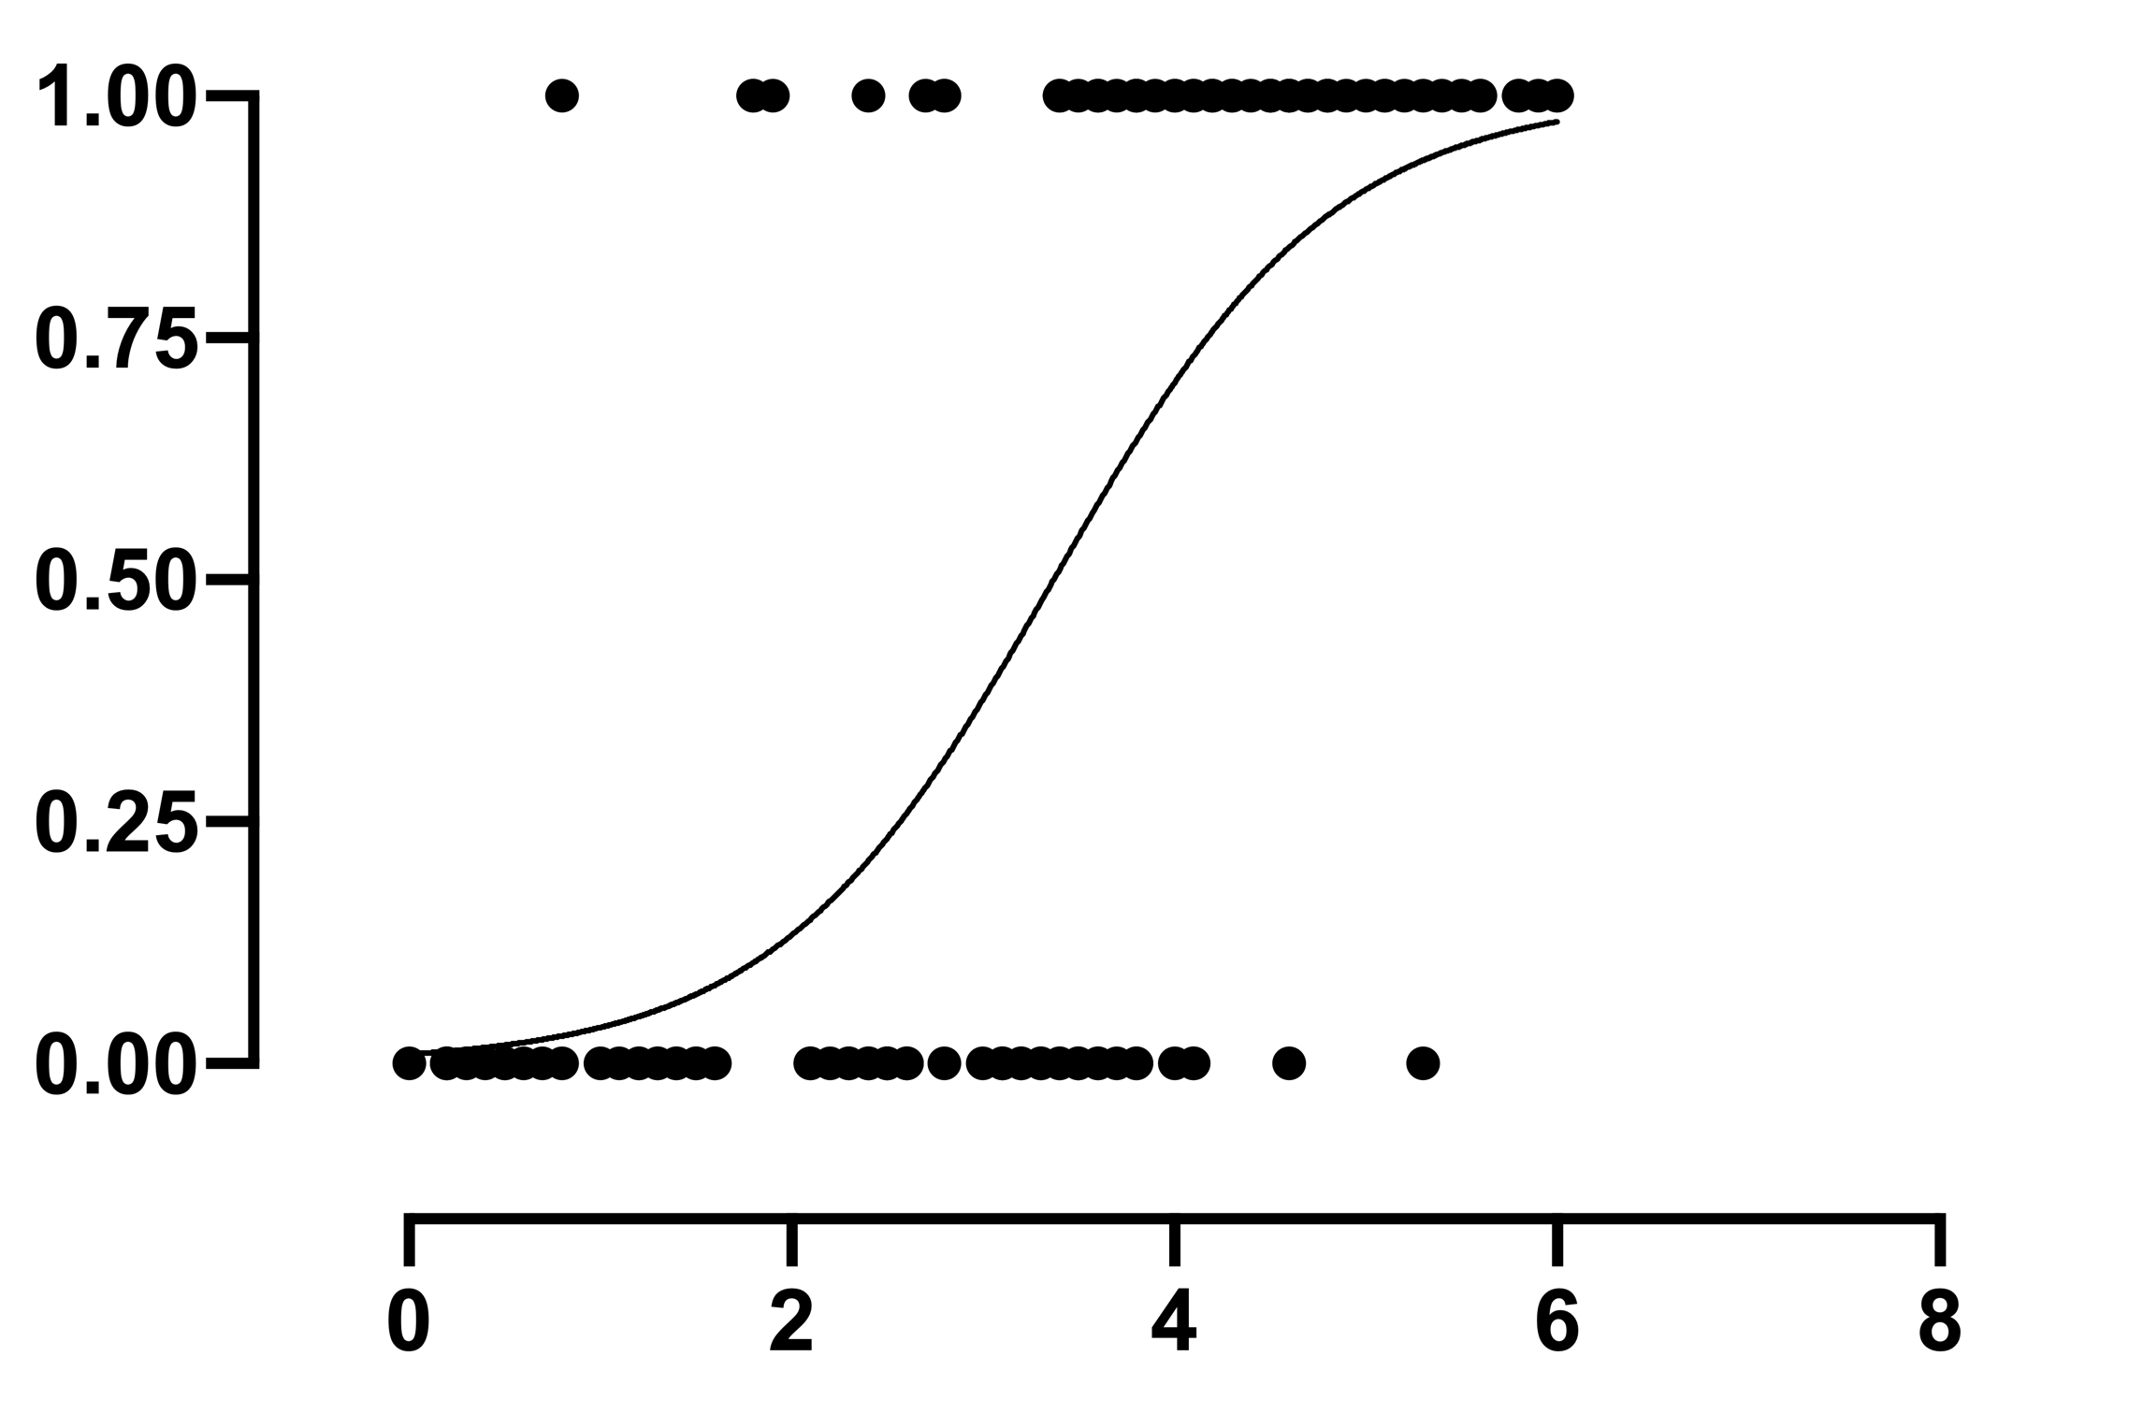
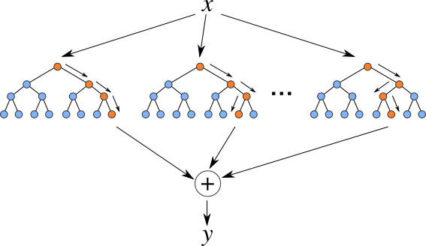
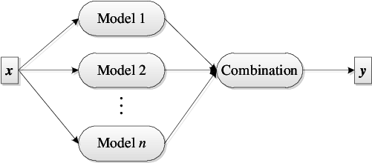
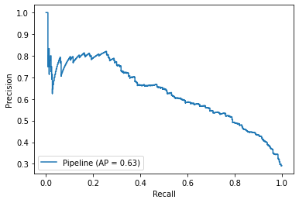
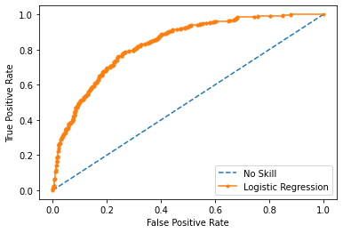
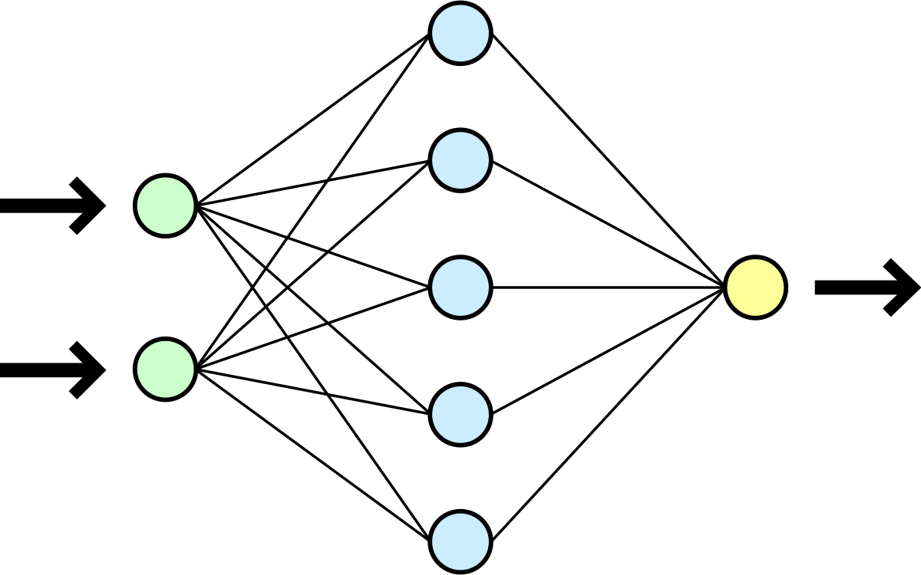
Churn Forecasting
How ?
Step 1: Traditional Machine Learning
Logistic Regression
Random Forest
Ensemble Model
Step 2: Deep Learning
Step 3: Evaluate, Select & Save
Neural Net Classification

Slide 7
Churn Forecasting
NOTEBOOK DEMO

